Slide 1
Advanced OOP Concepts
Notes:
Note from Chuck. If you are using these materials, you can remove the UM logo and replace it with your own, but please retain the CC-BY logo on the first page as well as the acknowledgement page(s) at the end.

Slide 2
Why Learn Advanced OOP?
Build more complex and efficient systems.
Facilitate real-world application design.
Encourage reusable and scalable code.

Slide 3
What is Inheritance?
Mechanism where a child class acquires properties and behaviors of a parent class.
Example:
Parent Class: Person
Child Class: Student

Slide 4
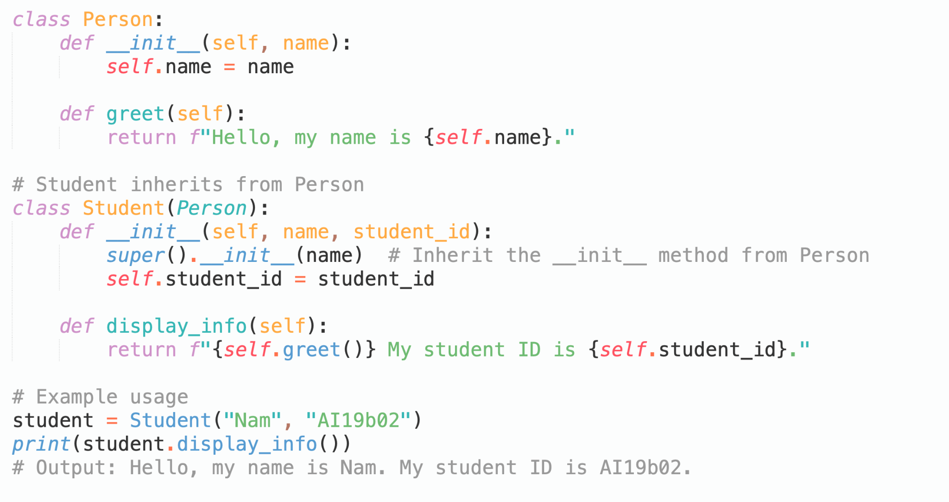
Example: Inheritance

Slide 5
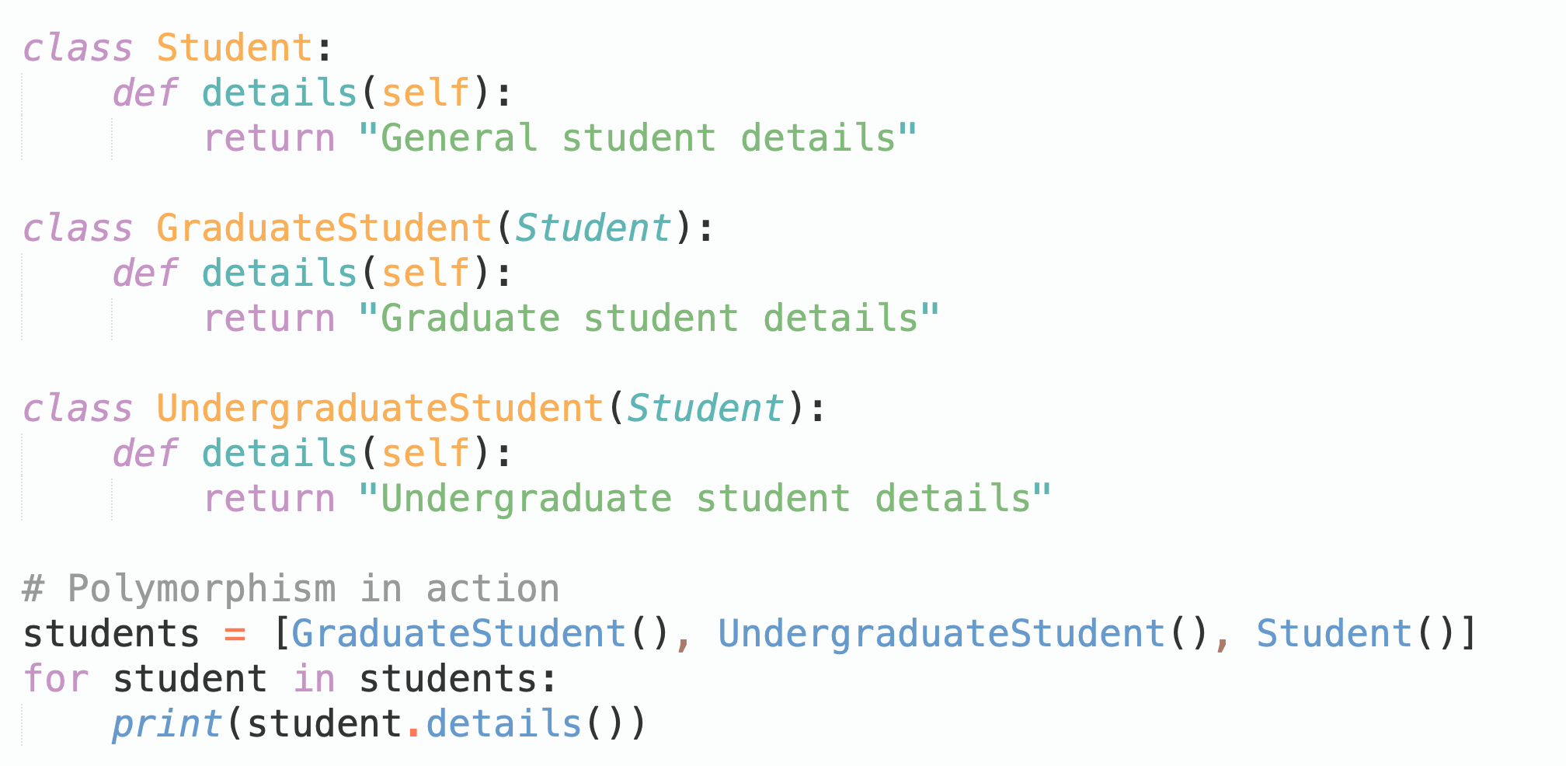
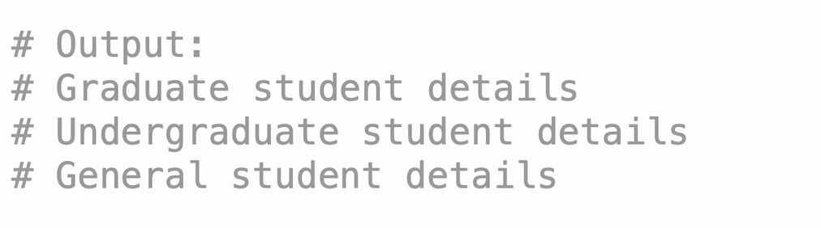
What is Polymorphism?
The ability of different objects to respond to the same function call in their own way.

Slide 6
Why Work with Multiple Objects?
Real-world applications often require handling multiple objects simultaneously.
Example: Managing a list of students in a school system or books in a library.

Slide 7
Why Work with Multiple Objects?
How to Work with Objects?
Use collections like lists to store objects.
Iterate through objects to perform operations (e.g., printing details, updating attributes).

Slide 8
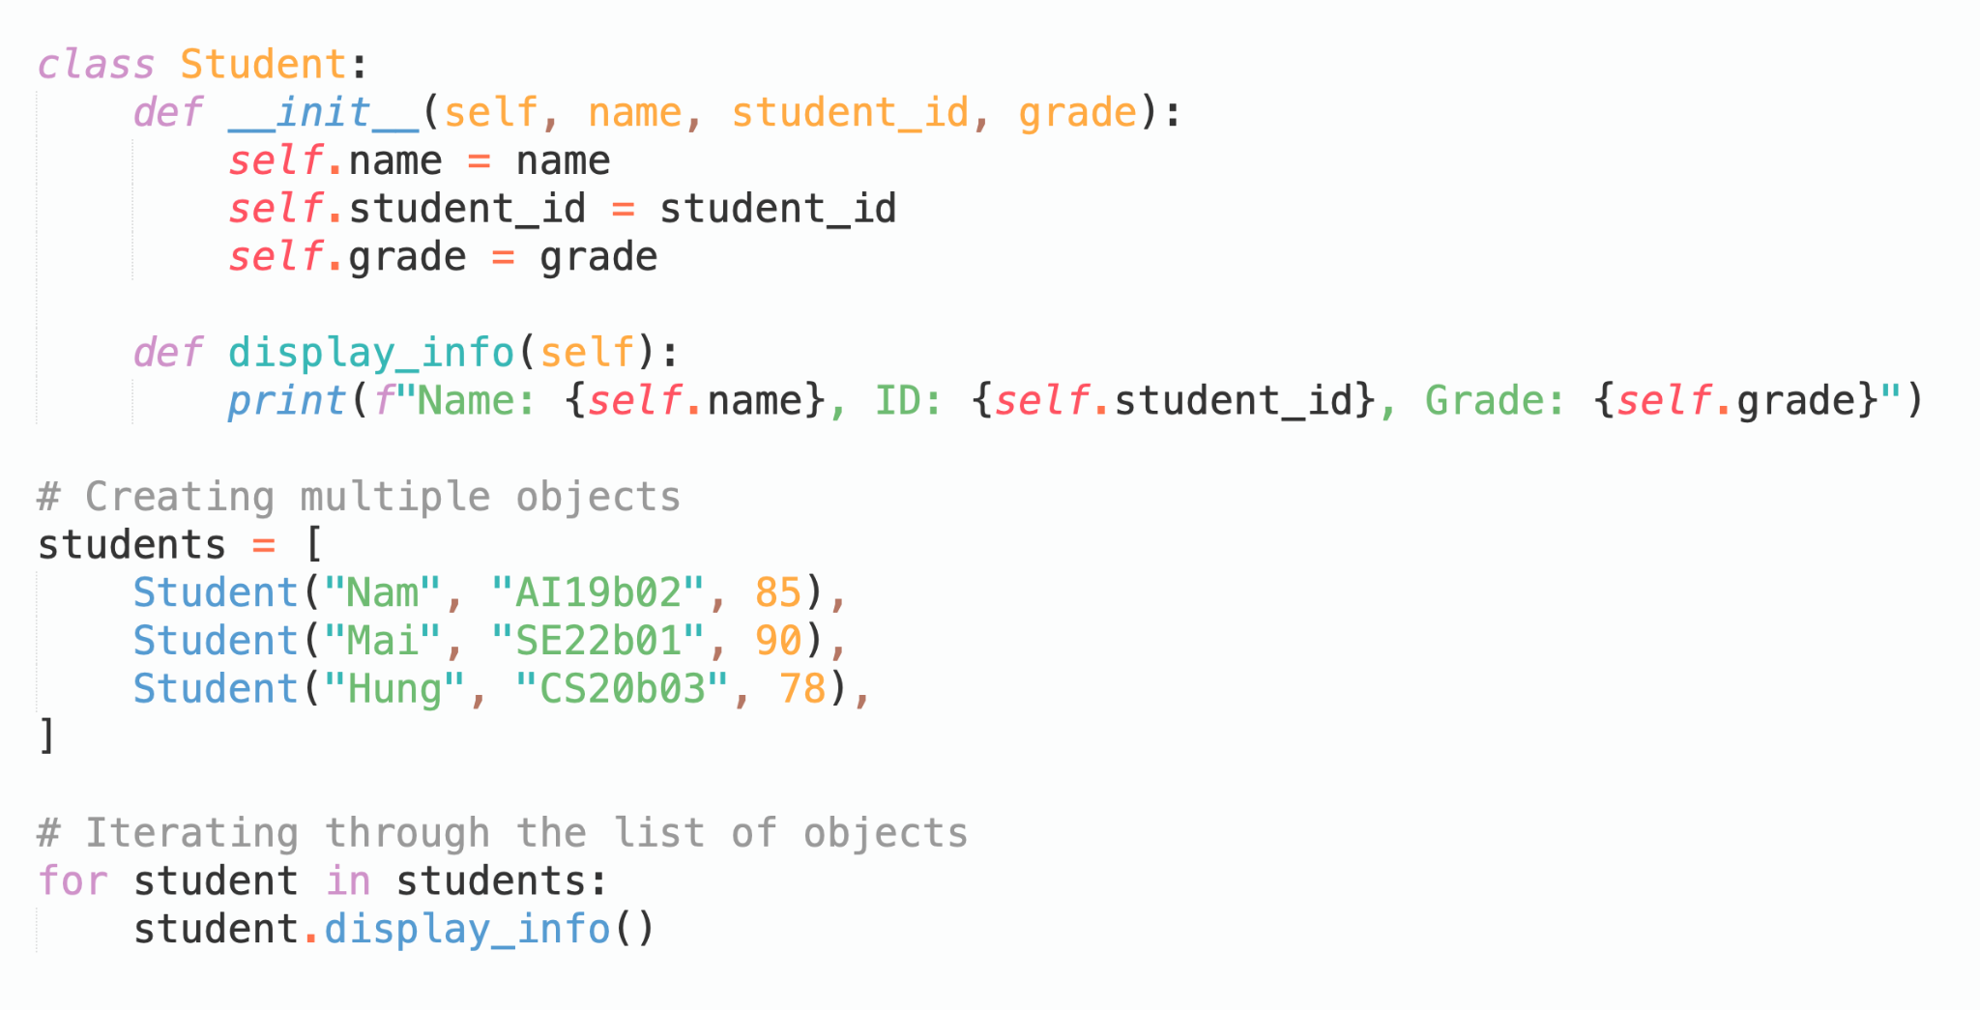
Using Objects in OOP

Slide 9
What is Method Overriding?
Redefining a parent class method in the child class to modify its behavior.
Example:
A child class Student overrides the greet method of the parent class Person.

Slide 10
Example: Method Overriding
Redefining a parent class method in the child class to modify its behavior.
Example:
A child class Student overrides the greet method of the parent class Person.

Slide 11
Enhancing Encapsulation
Protect sensitive methods and attributes in complex systems.
Enable subclass access using protected attributes.
Use property decorators (@property) for advanced data access control.

Slide 12
Enhancing Encapsulation
Why It Matters?
Prevent unauthorized changes to sensitive data.
Allow controlled modification of critical attributes.

Slide 13
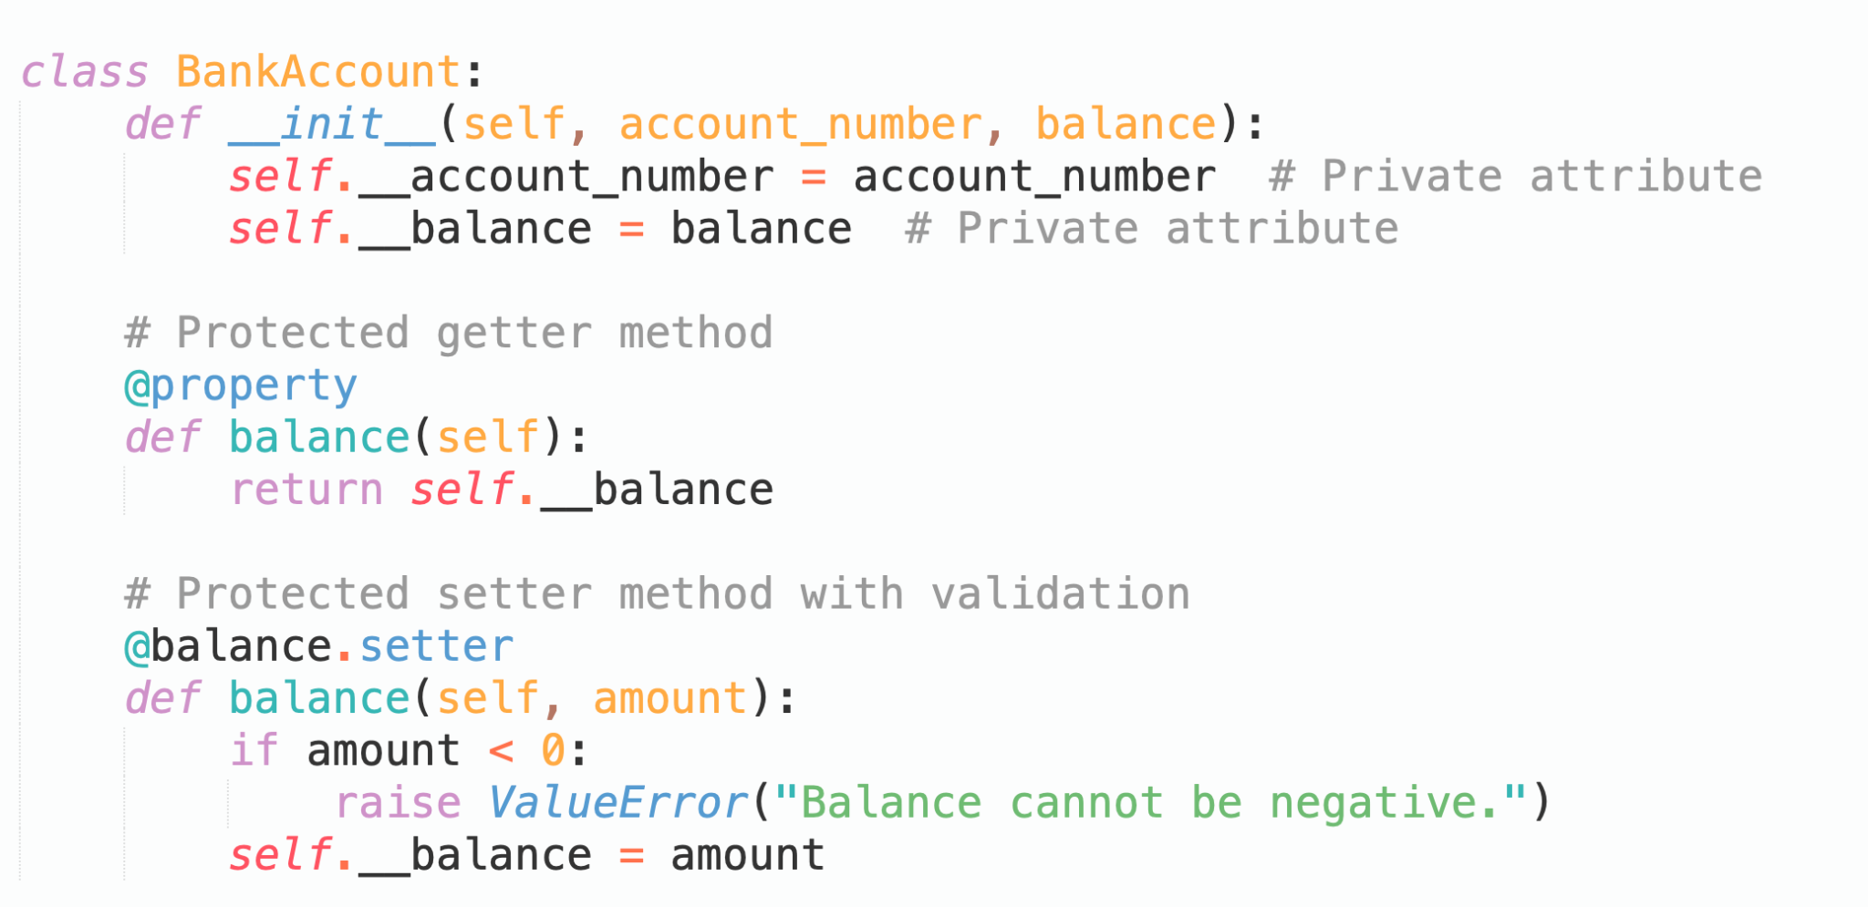
Enhancing Encapsulation

Slide 14
Enhancing Encapsulation
Why It Matters?
Prevent unauthorized changes to sensitive data.
Allow controlled modification of critical attributes.

Slide 15
Design Patterns
Templates for solving common programming problems.
Types: Creational (e.g., Singleton), Structural (e.g., Adapter), Behavioral (e.g., Observer).

Slide 16
OOP in Real-World Systems
Example: A library management system using inheritance, polymorphism, and encapsulation.

Slide 17
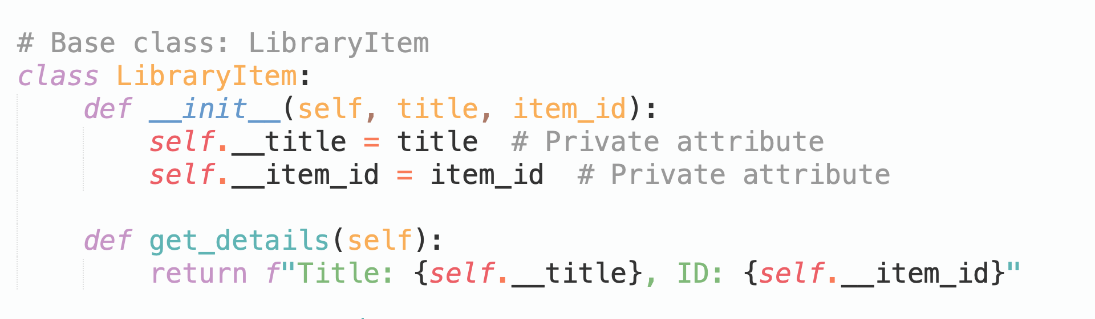
OOP in Real-World Systems

Slide 18
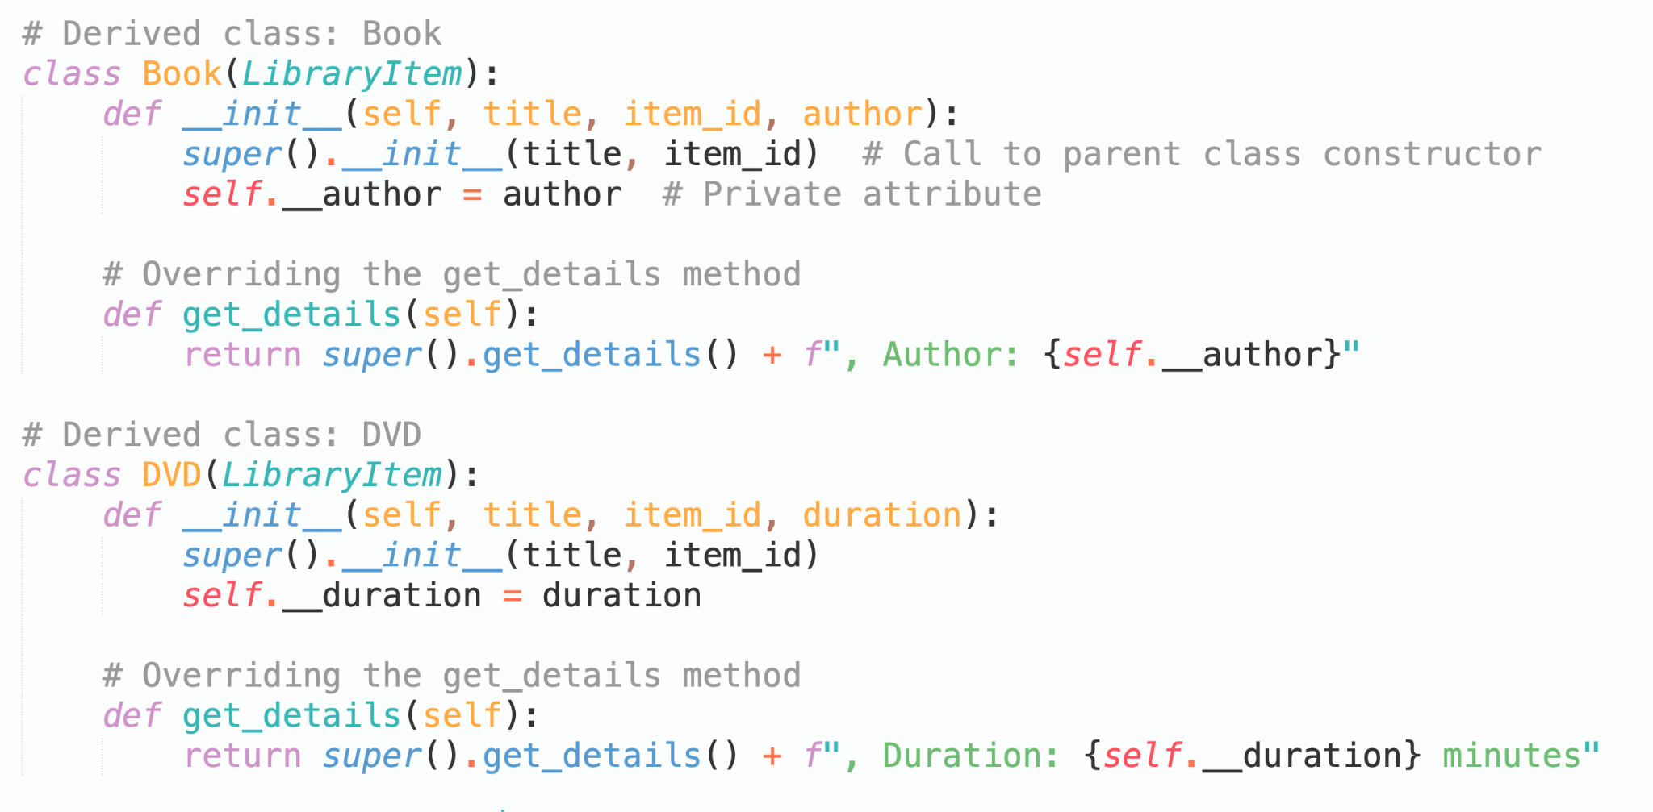
OOP in Real-World Systems

Slide 19
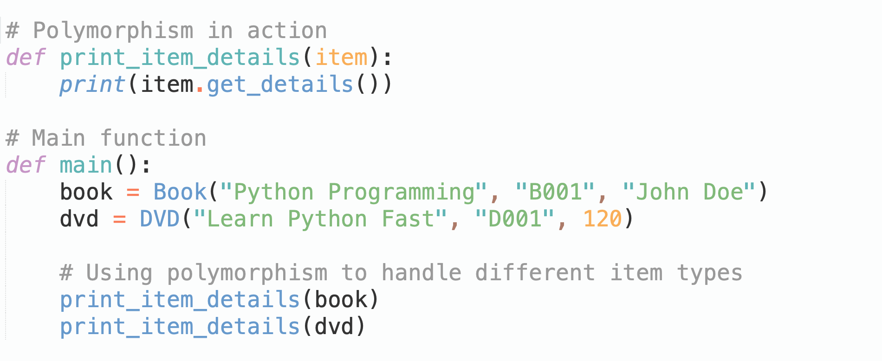
OOP in Real-World Systems

Slide 20
Where to Learn More
Links and References:
Python Documentation: https://docs.python.org
OOP Best Practices: https://realpython.com
Design Patterns in Python: https://refactoring.guru/design-patterns/python

Slide 21
Summary
Inheritance: Enables reusability by sharing behaviors across parent and child classes.
Polymorphism: Allows flexibility by enabling different objects to use the same interface.
Design Patterns: Provides reusable solutions to common software problems.

